Slide 1

LJMU MSc DS/ML C28

Slide 2


Course: MSDS/ML
Live Session On: Revision Generative AI: From RNN to GPT
Instructor: Dr. Jyoti Dabass

Slide 3
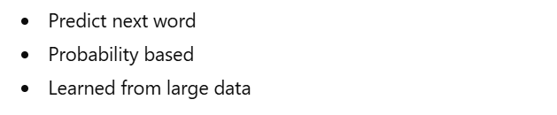
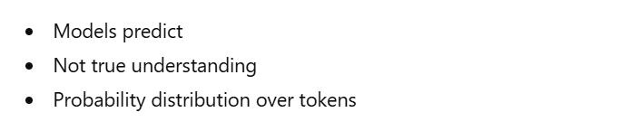
Understanding Next Word Prediction
Notes:
Note to SMEs: Start the session with a recall of the concepts taught in core content would help build a connection between the two
For example, if teaching a session on e-skills, asking the learners what they understood from the first module or the core concepts that were taught in module

Slide 4
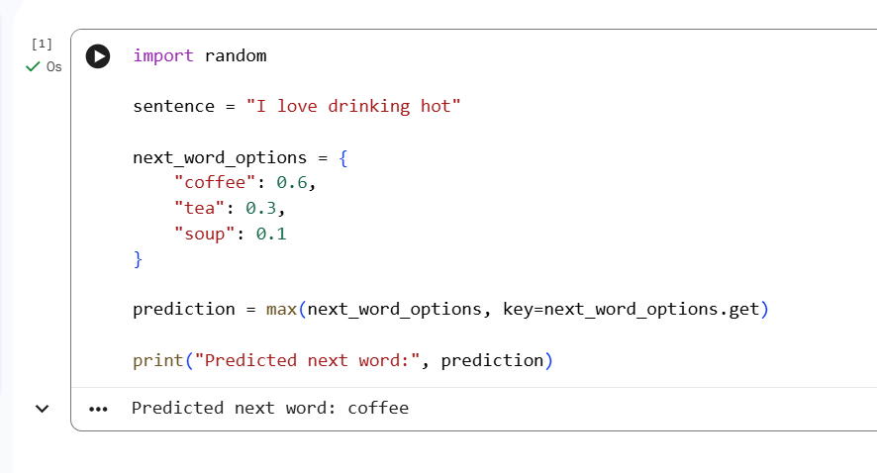
Code (Google Colab Link)
Notes:
Note to SMEs: Start the session with a recall of the concepts taught in core content would help build a connection between the two
For example, if teaching a session on e-skills, asking the learners what they understood from the first module or the core concepts that were taught in module

Slide 5
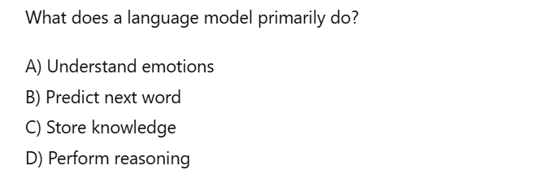
MCQ 1
Notes:
Note to SMEs: Start the session with a recall of the concepts taught in core content would help build a connection between the two
For example, if teaching a session on e-skills, asking the learners what they understood from the first module or the core concepts that were taught in module

Slide 6
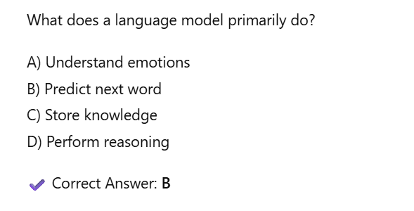
MCQ 1 (Answer)
Notes:
Note to SMEs: Start the session with a recall of the concepts taught in core content would help build a connection between the two
For example, if teaching a session on e-skills, asking the learners what they understood from the first module or the core concepts that were taught in module

Slide 7
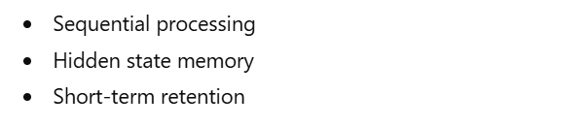
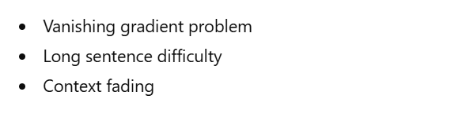
Why Early Models Struggled — RNN
Notes:
Note to SMEs: Start the session with a recall of the concepts taught in core content would help build a connection between the two
For example, if teaching a session on e-skills, asking the learners what they understood from the first module or the core concepts that were taught in module

Slide 8
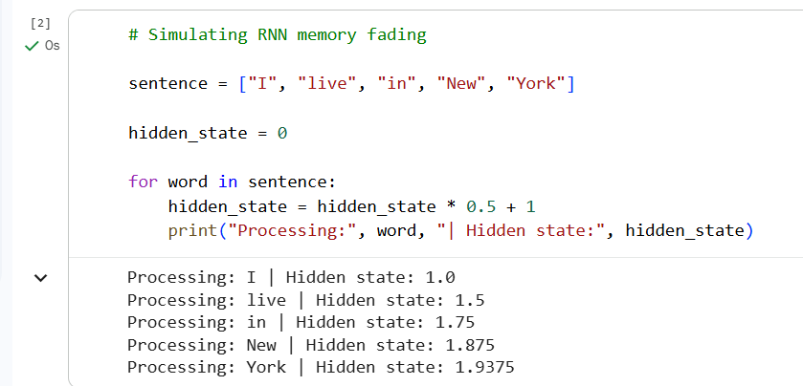
Code (Google Colab Link)

Slide 9
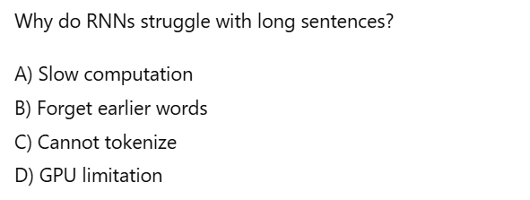
MCQ 2

Slide 10
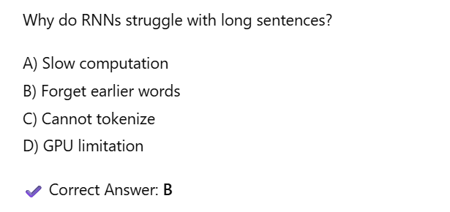
MCQ 2 (Answer)

Slide 11
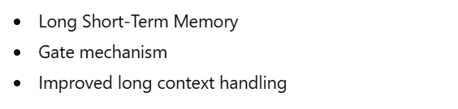
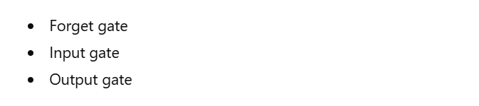
LSTM — Solving the Memory Problem

Slide 12
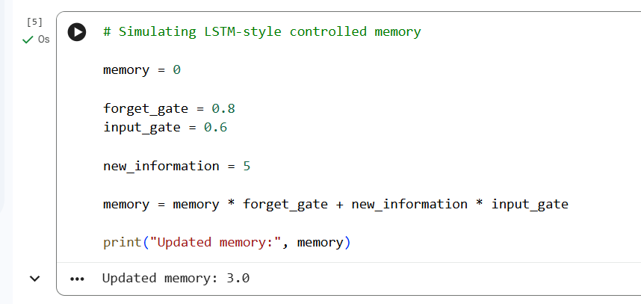
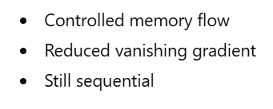
Code (Google Colab Link)

Slide 13
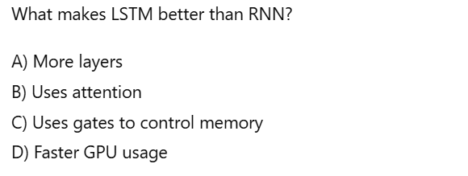
MCQ 3

Slide 14
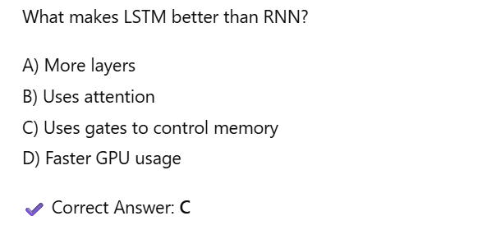
MCQ 3 (Answer)

Slide 15
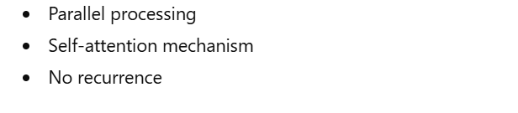
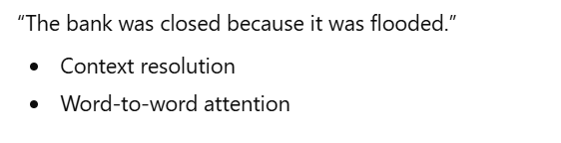
The Breakthrough — Transformers

Slide 16
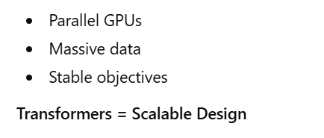
Why 2017 Changed Everything

Slide 17
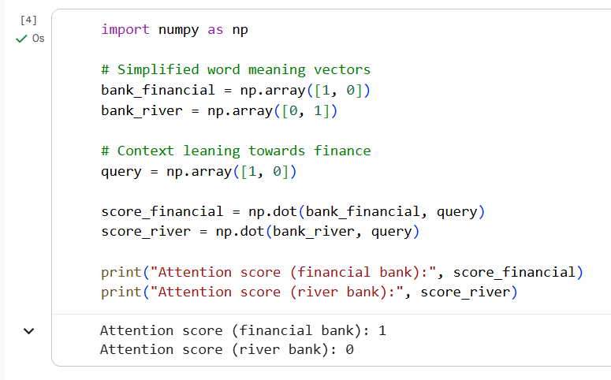
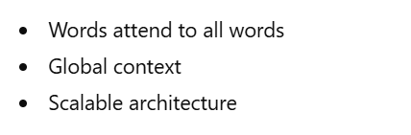
Code (Google Colab Link)

Slide 18
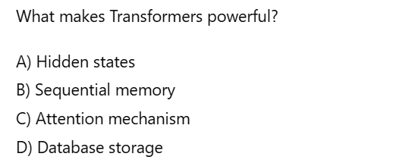
MCQ 4

Slide 19
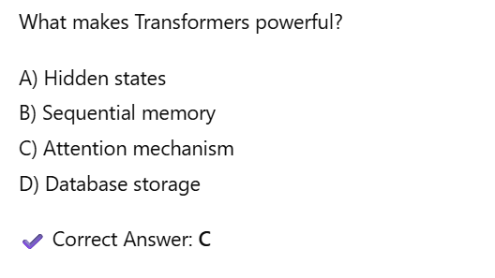
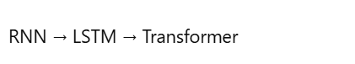
MCQ 4 (Answer)

Slide 20
From Transformer to Real Models
Two Directions Emerged:
1. Models that Generate Text
2. Models that Understand Text
GPT → Generative
BERT → Understanding
Both built on Transformers
Architecture design defines behavior

Slide 21
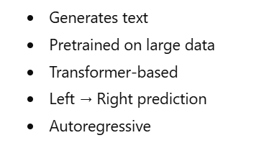
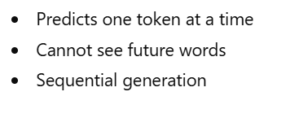
GPT — Generative Pretrained Transformer

Slide 22
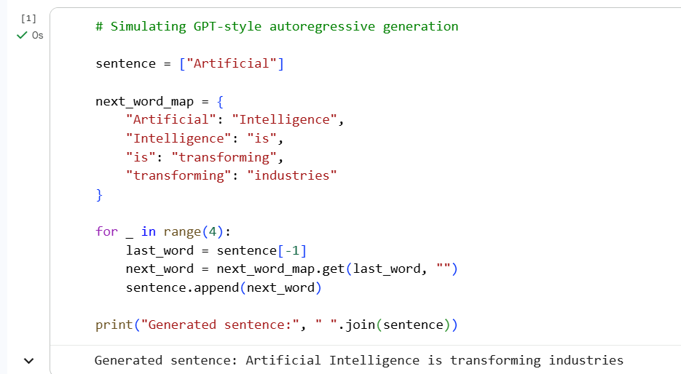
Code (Google Colab Link)

Slide 23
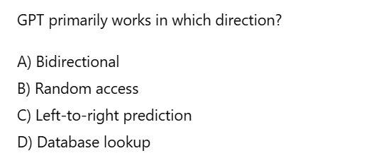
MCQ 5

Slide 24
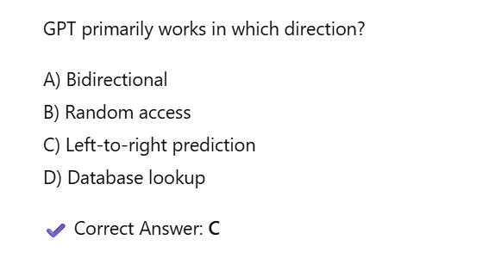
MCQ 5 (Answer)

Slide 25
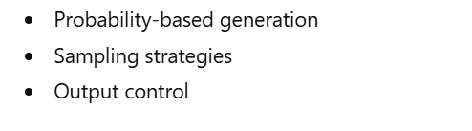
Controlling GPT Output — Sampling

Slide 26
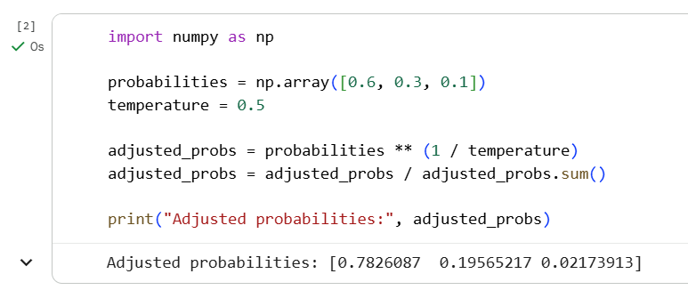
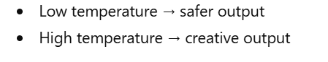
Code — Temperature (Google Colab Link)

Slide 27
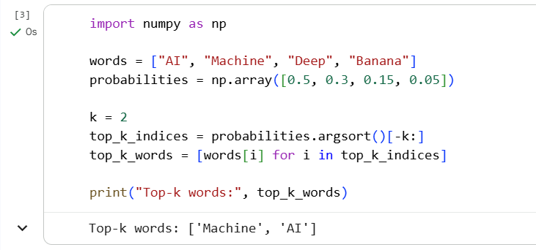
Top-k Sampling

Slide 28
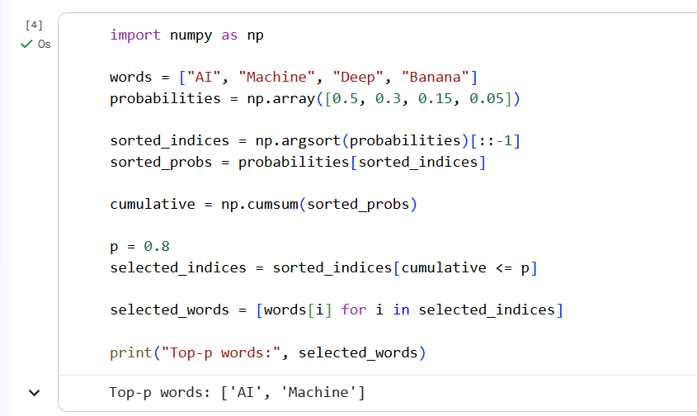
Top-p (Nucleus Sampling)

Slide 29
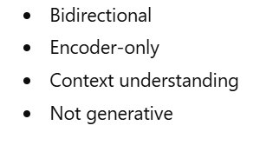
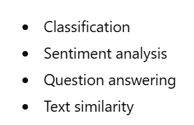
BERT — Bidirectional Encoder Representations from Transformers

Slide 30
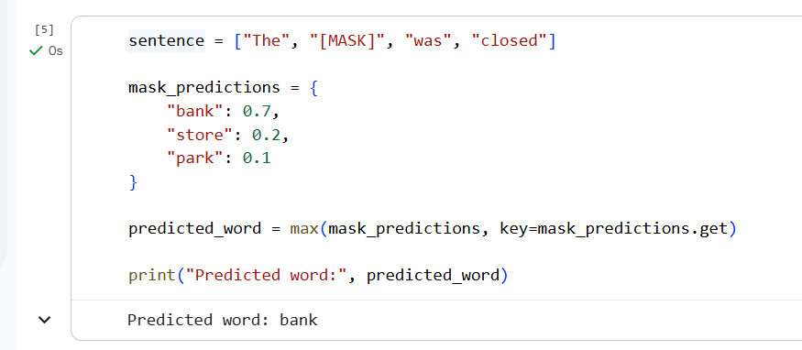
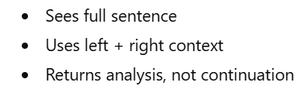
Code (Google Colab Link)

Slide 31
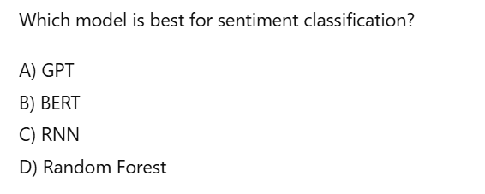
MCQ 6

Slide 32
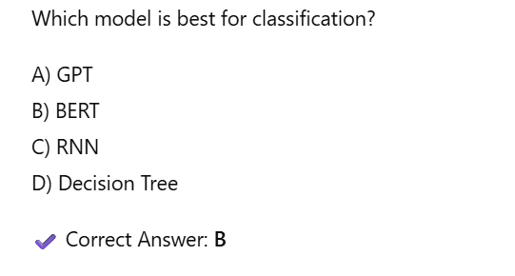
MCQ 6 (Answer)

Slide 33
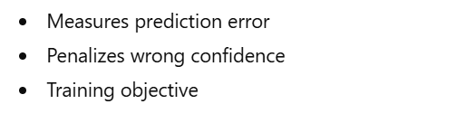
How Models Learn — Cross-Entropy Loss

Slide 34
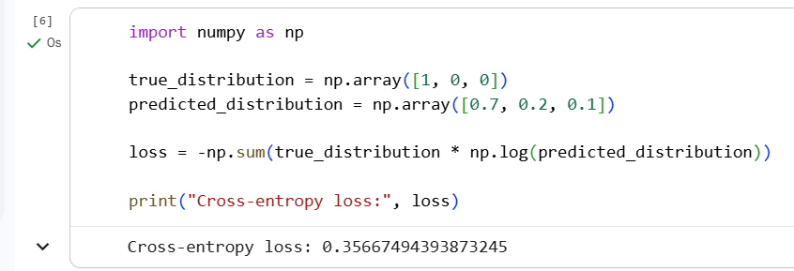
Code — Cross-Entropy

Slide 35
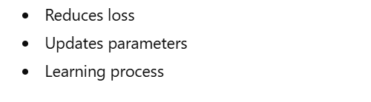
Gradient Descent — Weight Update

Slide 36
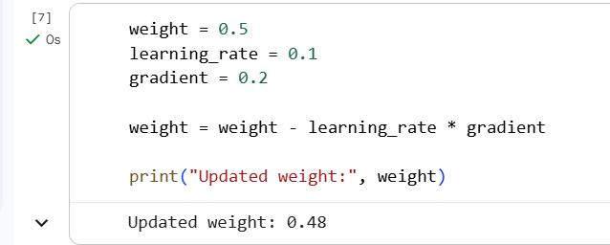
Code — Gradient Update

Slide 37
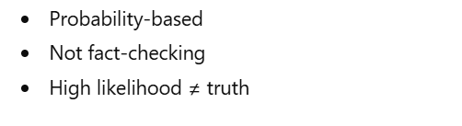
Why Do LLMs Hallucinate?

Slide 38
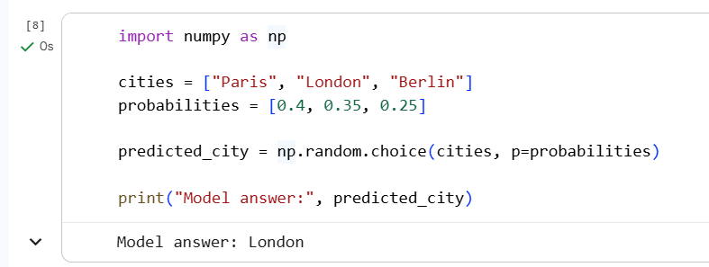
Code — Probability Selection

Slide 39
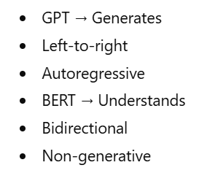
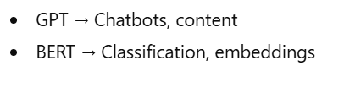
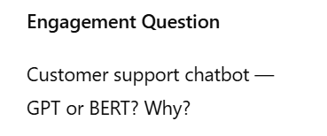
GPT vs BERT — Clear Comparison

Slide 40
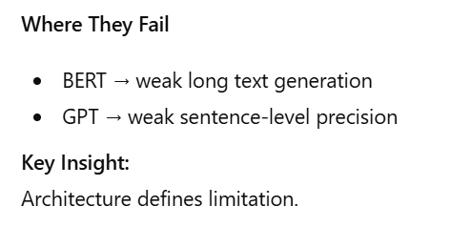
GPT vs BERT — Clear Comparison

Slide 41

MCQ 7

Slide 42

MCQ 7 (Answer)

Slide 43

How Do We Reduce Hallucination?

Slide 44

Prompt Engineering — The Art of Talking to AI

Slide 45


Code (Google Colab Link)

Slide 46

MCQ 8

Slide 47

MCQ 8 (Answer)

Slide 48



Few-Shot Learning: Teaching by Example

Slide 49

MCQ 9

Slide 50

MCQ 9 (Answer)

Slide 51




RAG: Retrieval Augmented Generation

Slide 52

MCQ 10

Slide 53

MCQ 10 (Answer)

Slide 54


RAG vs Fine-Tuning

Slide 55

MCQ 11

Slide 56

MCQ 11 (Answer)

Slide 57



Enterprise AI Architecture

Slide 58

MCQ 12

Slide 59

MCQ 12 (Answer)

Slide 60



Multimodal AI

Slide 61

MCQ 13

Slide 62

MCQ 13 (Answer)

Slide 63

Closing Slide

Slide 64


How Do We Know If an LLM Is Actually Good?

Slide 65



Automatic Evaluation Metrics

Slide 66


Code (Google Colab Link)

Slide 67

MCQ 14

Slide 68

MCQ 14 (Answer)

Slide 69



Human Evaluation — Still Critical

Slide 70


Bias and Ethics

Slide 71


Code (Google Colab Link)

Slide 72

MCQ 15

Slide 73

MCQ 15 (Answer)

Slide 74


How Do We Reduce Bias?

Slide 75



Deployment — Cloud vs On-Premise

Slide 76

MCQ 16

Slide 77

MCQ 16 (Answer)

Slide 78



Cost vs Latency vs Accuracy Trade-Off

Slide 79


What Happens After Deployment? — LLMOps

Slide 80


LLMOps — In Practice

Slide 81


Code (Google Colab Link)

Slide 82

MCQ 17

Slide 83

MCQ 17 (Answer)

Slide 84



Human-in-the-Loop Systems

Slide 85

Engagement Checkpoint

Slide 86

Final Transition

Slide 87

From User to Builder — The Mindset Shift

Slide 88

AI Is a Decision System

Slide 89

Common Mistake #1 — Blind Trust

Slide 90

MCQ 18

Slide 91

MCQ 18 (Answer)

Slide 92

Common Mistake #2 — No Clear Boundaries

Slide 93

Common Mistake #3 — Treating AI as Final Authority

Slide 94

Thinking Like an AI Architect

Slide 95

Thinking Like a Researcher

Slide 96

Choosing the Right Level of Effort

Slide 97

Enterprise Reality

Slide 98

Staying Relevant in AI

Slide 99

Your Role in AI Systems

Slide 100

MCQ 19

Slide 101

MCQ 19 (Answer)

Slide 102

Transition Slide

Slide 103


AI Outputs Are Probabilistic, Not Authoritative

Slide 104


Code (Google Colab Link)

Slide 105

MCQ 20

Slide 106

MCQ 20 (Answer)

Slide 107


The Biggest Risk — When AI Sounds Confident

Slide 108

Prompt Injection — A Real Security Risk

Slide 109


Code (Google Colab Link)

Slide 110

MCQ 21

Slide 111

MCQ 21 (Answer)

Slide 112


Corporate Reality — Responsibility Cannot Be Delegated

Slide 113


The Professional Mindset

Slide 114

Transition Slide

Slide 115


From Learning Concepts to Identifying Gaps

Slide 116


How to Detect a Research Problem

Slide 117


Narrowing Your Research Focus

Slide 118


Structure of a Strong Master’s Thesis

Slide 119

MCQ 22

Slide 120

MCQ 22 (Answer)

Slide 121


Thinking in Terms of Variables

Slide 122


Importance of Baselines

Slide 123

Transition Slide

Slide 124


Experimentation Is Not Trial and Error

Slide 125


Role of Hypothesis in Research

Slide 126


What Makes Results Credible

Slide 127


Why Documentation Matters

Slide 128


Common Thesis Mistakes to Avoid

Slide 129


Analysis Is More Important Than Numbers

Slide 130


Interpreting Results Carefully

Slide 131

MCQ 23

Slide 132

MCQ 23 (Answer)

Slide 133


Connecting Research With Real-World Impact

Slide 134


Final Research Mindset Shift

Slide 135

Transition Slide (Session Continues)

Slide 136

How to Read Research Papers AFTER This Session

Slide 137


What We Have Covered So Far

Slide 138



Generalization vs Memorization

Slide 139



Alignment Problem

Slide 140



Interpretability

Slide 141



Evaluation Beyond Accuracy

Slide 142



Multimodality

Slide 143



Responsible AI

Slide 144



Open Research Directions

Slide 145


What You Should Be Able To Do Now

Slide 146



Final Research Mindset

Slide 147



Strong Academic Closing

Slide 148
Thank You!

